Slide 1
Presentation Assignment 1: 19AIE101 Elements of computing systems 1
Submitted by Group Number -43
Names of Group members : 1. VIKHYAT BANSAL
2. YALAVARTHI HIMA
3. YARRAM SRI SATHWIK REDDY
4. YETURU SHASHANK REDDY

Slide 2
DECIMAL TO OCTAL CONVERSION
1. If the given decimal number is less than 8 the octal number is the same
2. if the decimal number is greater than 7 then divide the number by 8
3. Note the remainder ,we get after division
4. Repeat step 2 and 3 with the quotient till it is less than 8
5. Now ,write the remainders in reverse order (bottom to top)
6. The resultant is the equivalent octal number to the given decimal number

Slide 3
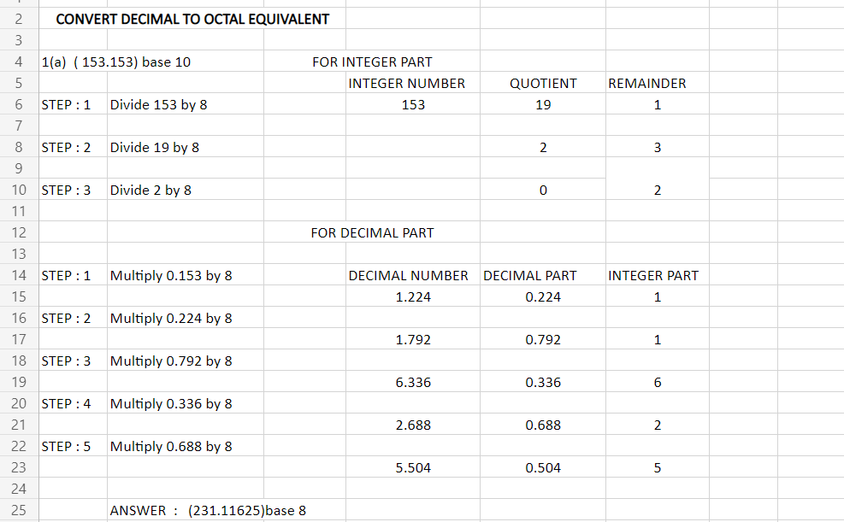
QUESTION : 1
(a) (153.153)base10

Slide 4
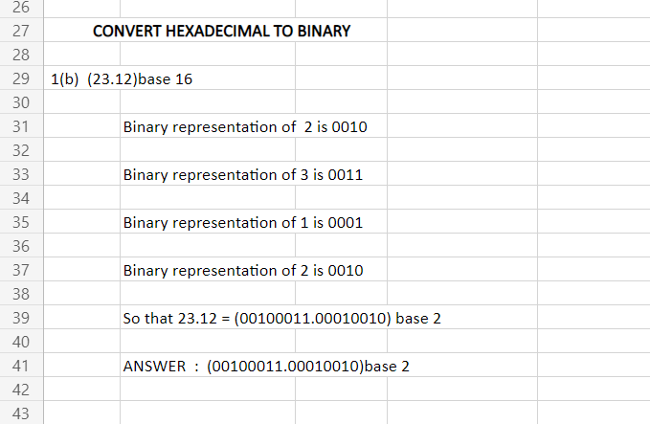
(b) (23.12)base 16
Conversion of hexadecimal to binary
Translate every hexadecimal digit into 4 - bit binary equivalent

Slide 5


BINARY TO DECIMAL CONVERSION
Each digit position of a binary number has a weight
-some power of 2
A binary number :
Corresponding value in decimal :

Slide 6
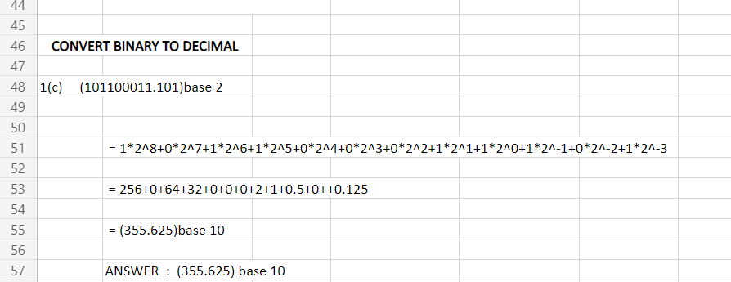
c) (101100011.101)base 2

Slide 7
HEXA DECIMAL TO DECIMAL CONVERSION
To convert a hexadecimal to a decimal manually ,you must start by multiplying the hexadecimal
number by 16 .Then ,you raise it to power of 0 and increase that power by 1 each time according to
The hexadecimal number equivalent .

Slide 8
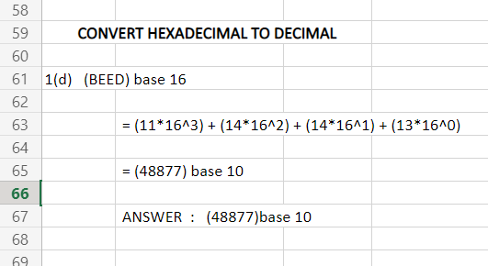
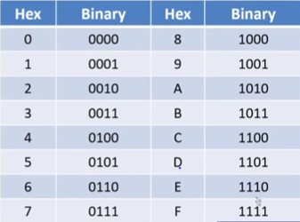
CONVERT HEXADECIMAL TO DECIMAL
(d) (BEED)base 16

Slide 9
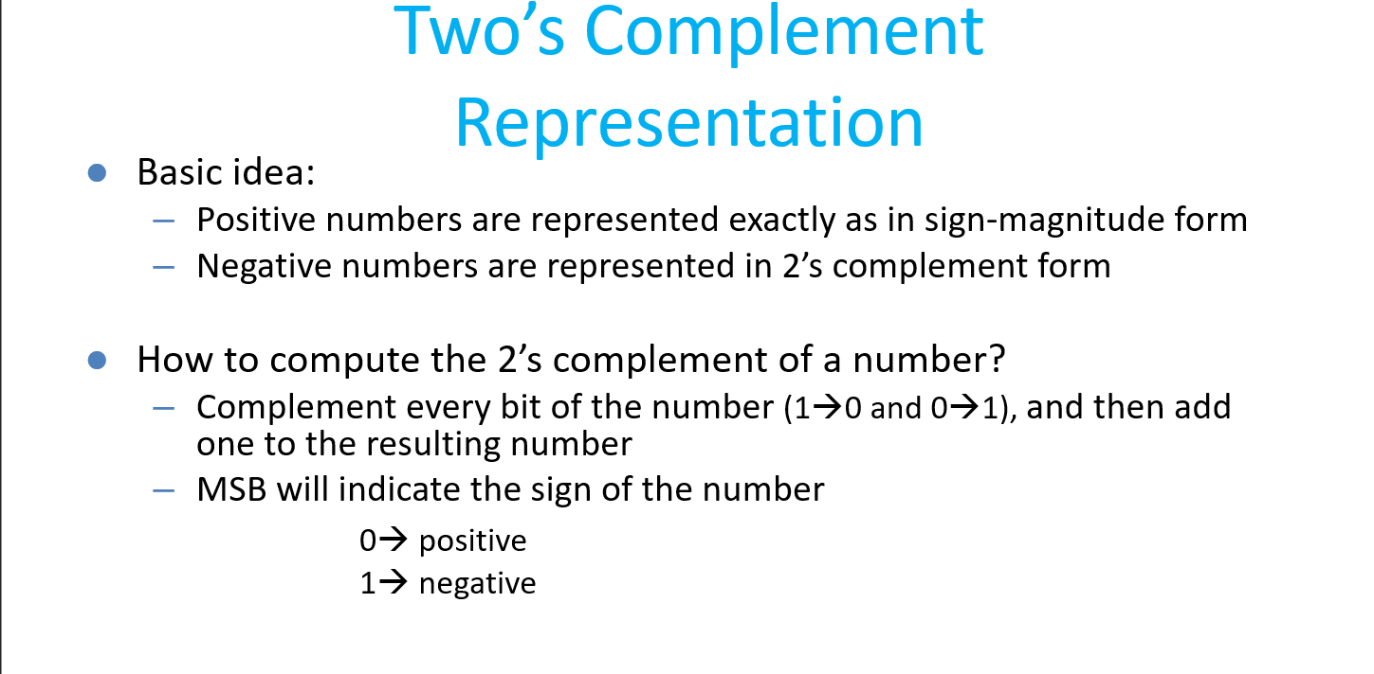
QUESTION : 2
a) Find the 2’s complement representation of 17. Justify your answer.

Slide 10
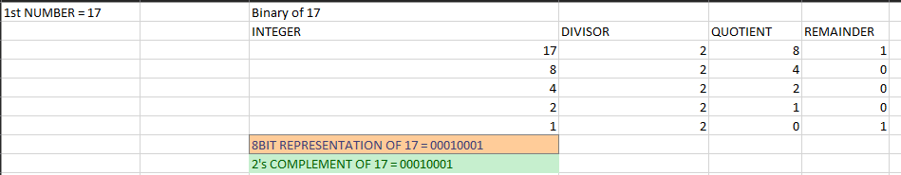
Positive numbers are represented exactly as in sign magnitude form

Slide 11
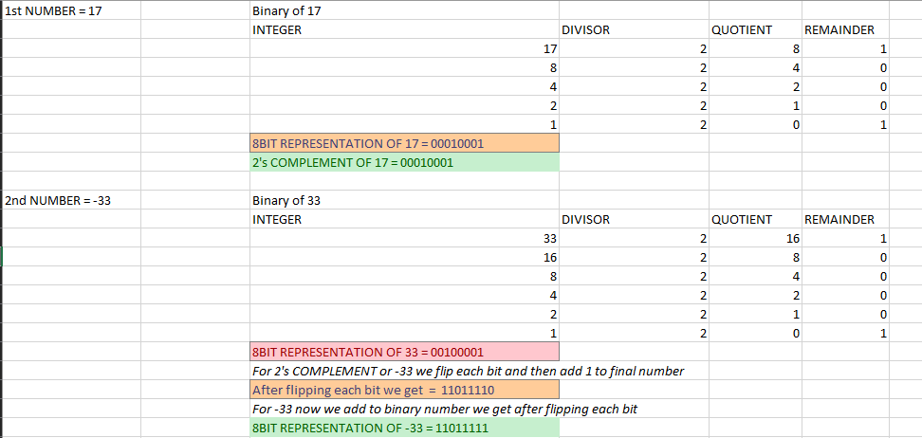
QUESTION : 2
b) Illustrate subtraction using 2’s complement (Take an example in 8-bit representation).
Let us take two 8bit binary number with different sign so that we can execute 8bit subtraction using 2’s complement

Slide 12
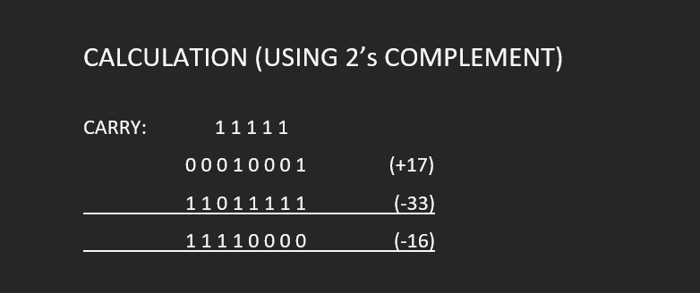
CALCULATION FROM 2’s COMPLEMENTS

Slide 13
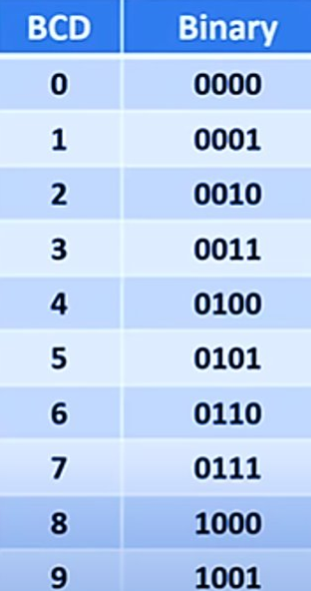
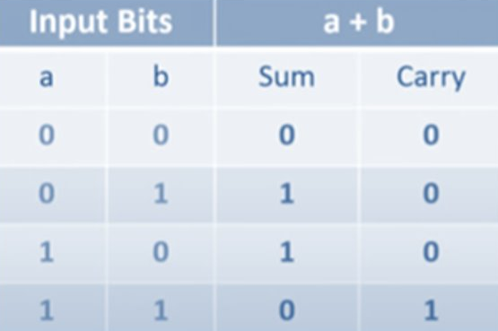
QUESTION : 3
Perform BCD Addition of the following decimals. Also indicate how many BCD corrections are required in (a) and (b)
a) 49 and 57
b) 176 and 824
* To perform BCD addition, we may have to go for a correction step where 6(0110) is added to one of the nibble.
* Either when a nibble is one of the six invalid combination, or there is a carry in form the previous nibble.
(nibble – A set of 4- bit binary number)
*The six 4- bit combinations 1010,1011,1100,1101
1110,and 1111 are unused

Slide 14
(a) 49 and 57
49 + 57 = 106
Carry : 1 1 1 1 1 1
0 1 0 0 1 0 0 1
0 1 0 1 0 1 1 1
-----------------------------
1 0 1 0 0 0 0 0
+ 0 1 1 0 (1) *(1)correction: there is a carry in from the previous nibble so, we have to
---------------------------- add 6 (0110)
Carry: 1 1 1
1 0 1 0 0 1 1 0
+ 0 1 1 0(2) *(2)correction: we are getting unused number
----------------------------- (1010) so we have to add 6 (0110)
0 0 0 1 0 0 0 0 0 1 1 0
-------------------------------------
1 0 6

Slide 15
(b) 176 and 824
176 + 824 = 1000
Carry : 1 1 1
0 0 0 1 0 1 1 1 0 1 1 0
1 0 0 0 0 0 1 0 0 1 0 0
---------------------------------------------
Carry : 1 1 1 1
1 0 0 1 1 0 0 1 1 0 1 0
+ 0 1 1 0 (1) *(1) correction we are getting unused number (1010) so we to add
6(0110) ---------------------------------------------
Carry : 1 1 1 1
1 0 0 1 1 0 1 0 0 0 0 0
+ 0 1 1 0 (2) *(2) correction we are getting unused number (1010) so we have to
--------------------------------------------- add 6 (0110)
Carry : 1 1 1
1 0 1 0 0 0 0 0 0 0 0 0
+ 0 1 1 0 (3) *(3) correction we are getting unused number (1010) so we have to
--------------------------------------------- add 6 (0110)
0 0 0 1 0 0 0 0 0 0 0 0 0 0 0 0
-----------------------------------------------------
1 0 0 0
------------------------------------------------------

Slide 16
QUESTION : 4
Illustrate the problem of overflow in binary addition (Take an example in 5-bit representation)
In computer architecture 2’s Complement Number System is widely used. The discussion of overflow here mainly will we with respect to 2’s Complimentary System.
N-bit 2’s Complement number System can represent Number from -2^(n-1) to 2^(n-1)-1 . 4 Bit can represent numbers from ( -8 to 7 ) 5 Bit can represent numbers from ( -16 to 15 ) in 2’s Complimentary System.
Overflow Occurs with respect to addition when 2 N-bit 2’s Complement Numbers are added and the answer obtained exceeds the actual range of numbers that can be represented using N bits.
A computer has N-Bit Fixed registers. Addition of two N-Bit Number will result in a max N+1 Bit number. That Extra Bit is stored in carry Flag. But Carry does not always indicate overflow.
Overflow occurs when:
Two negative numbers are added and an answer comes positive or
Two positive numbers are added and an answer comes as negative.

Slide 17
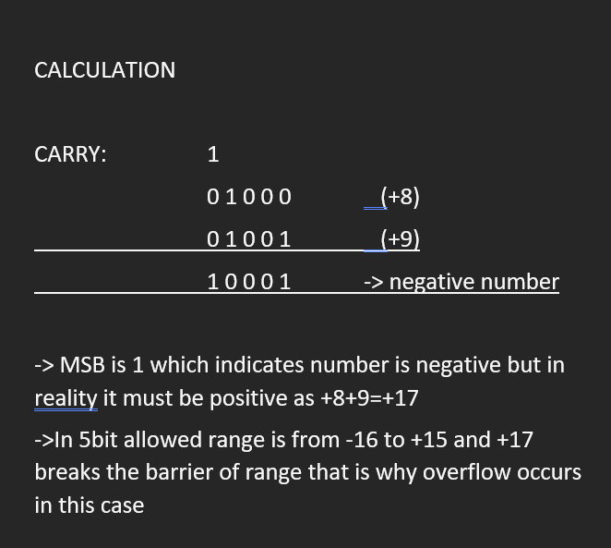
In 5bit allowed number of bits are in range:
-2^(n-1) to 2^(n-1)-1 = -16 to 15
So as an illustration whenever we try to do go over range barrier following happens
For example
8+9 in terms of 5bit we will always get
8=01000 (Binary of 8 in 5bit)
9=01001 (Binary of 9 in 5bit)

Slide 18

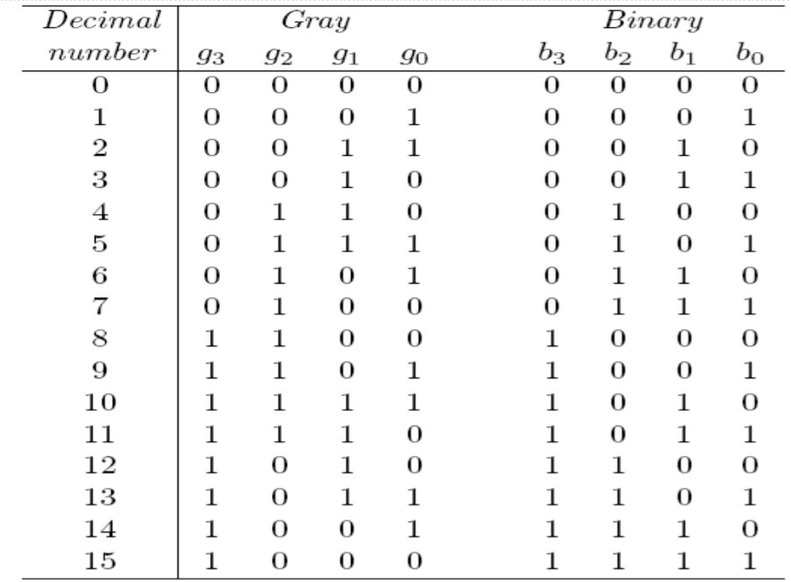
QUESTION : 5
Find the gray code equivalent of the 4-bit binary numbers. Show the procedure of conversion. How can we obtain the gray code representation for (m+1) bits from m-bits.
Gray code :
* Type of non-weighted binary code where successive code differ in only one bit as shown in fig:
* Code with this property is also called Cyclic code
* Use full in applications that require analog to digital conversions
* Use full to reduce error in conversions
* Binary to gray and gray to binary conversions are easier
* In Binary no. of bit changes are randomly
* It's a Self reflecting code because representation for (m+1) from m bits

Slide 19
Gray code representation for (m+1)bits from m bits:
* write the m bit representations, one below the other as mirror images to each other
* Add 0 at the beginning of every code in the first group, and 1 at the beginning of every code in the
Second group
00 0 00
01 0 01 0 000
11 0 11 0 001
10 0 10 0 011
----------------------------------------------- 0 010
1 10 0 110
1 11 0 111
1 01 0 101
1 00 0 100
---------------------------------------------------------------------------------------------
1 100
1 101
1 111
1 110
1 010
1 011
1 001
1 000

Slide 20
Question No.6 Realizing elementary logic gates using Nand Gate
What exactly is a Logic Gate ?
A Logic gate is a physical device which performs a Boolean function.

Slide 21
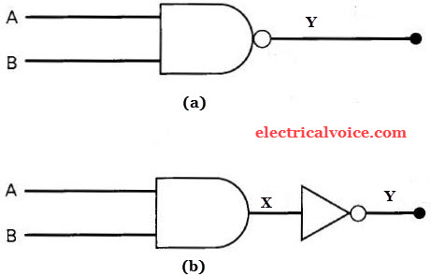
Fundamental logic gate - NAND
Nand Gate is the universal gate from which all other basis logic gates can be created.
Representation of NAND gate: Truth Table:
A | B | (A.B)`
0 | 0 | 1
1 | 0 | 1
0 | 1 | 1
1 | 1 | 0

Slide 22
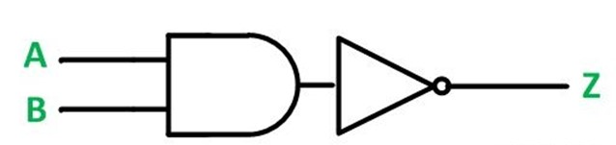
Interpreting Elementary gates using NAND Gate
Basically NAND gate is a combination of AND and Not gates i.e it generates the complement od AND gate.
By using the combinations of multiple Nand gates other gates like AND ,NOT, OR and NOR can be created.

Slide 23
AND Gate in terms of NAND Gate
Chip logic/ Diagram: A NAND produces complement of AND gate. So, if the output of a NAND gate is inverted, overall output will be that of an AND gate.
A
Output
B

Slide 24
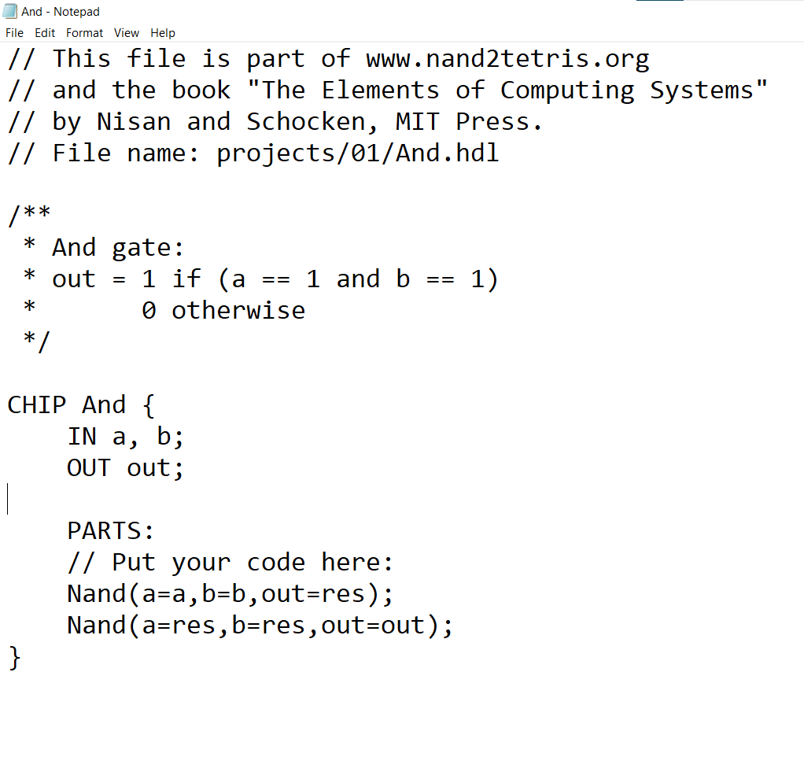
HDL script for AND Gate:

Slide 25
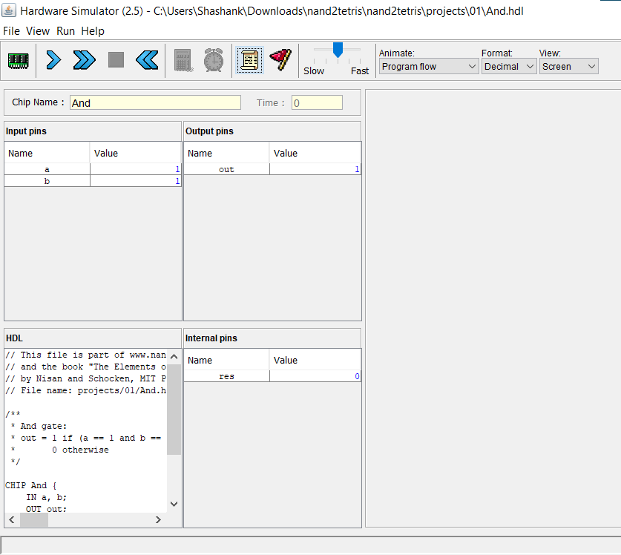
Result

Slide 26
NOT Gate using NAND
Chip logic:
A A’

Slide 27
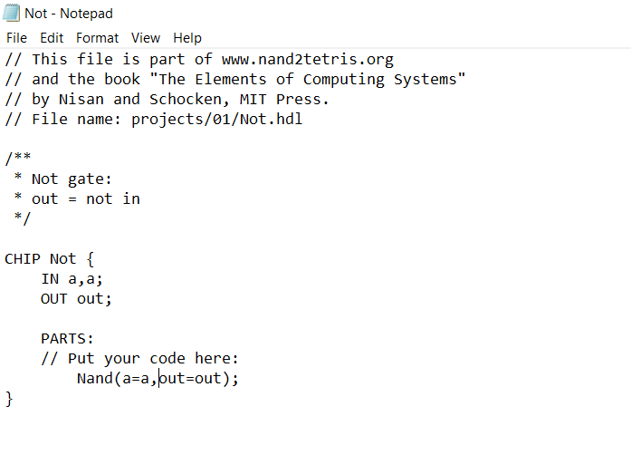
HDL script for NOT gate

Slide 28
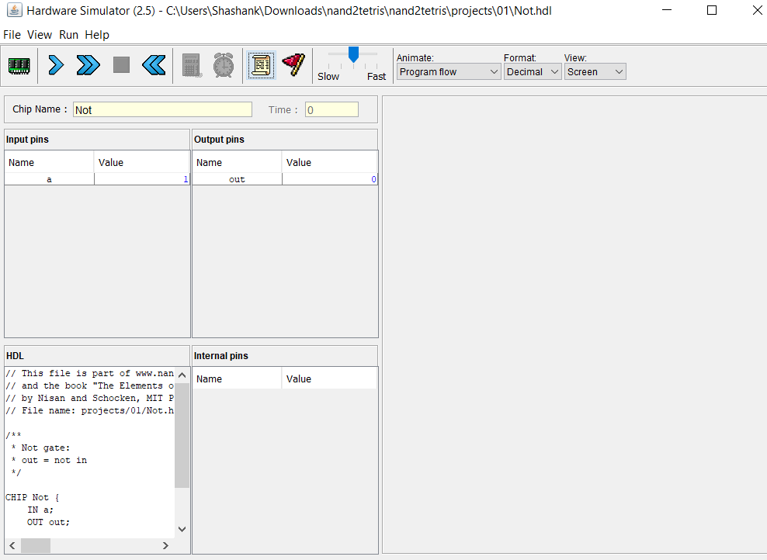
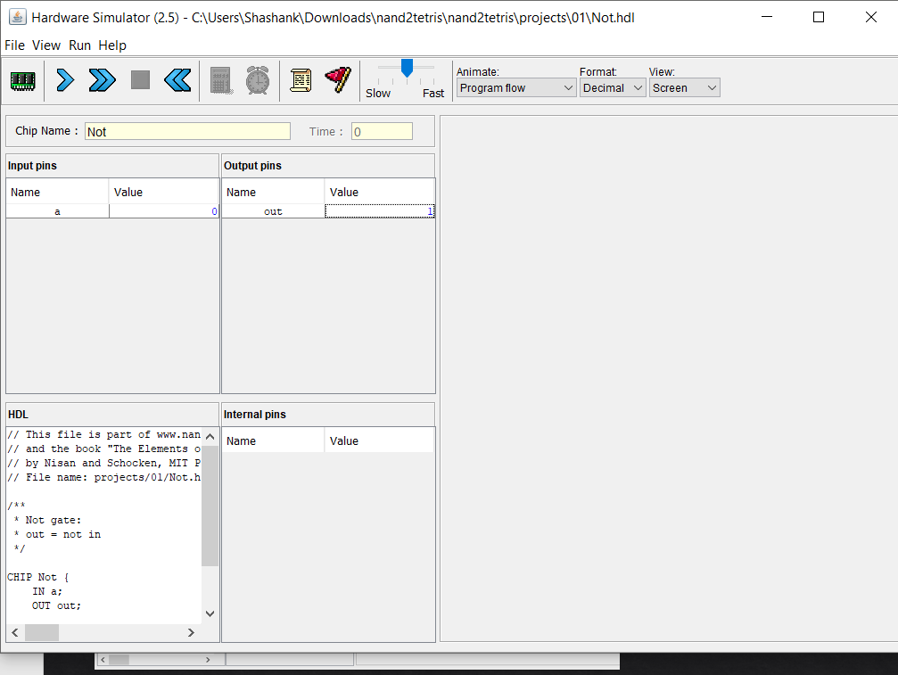
Result

Slide 29
OR Gate
Gate logic:
A
A+B
B

Slide 30
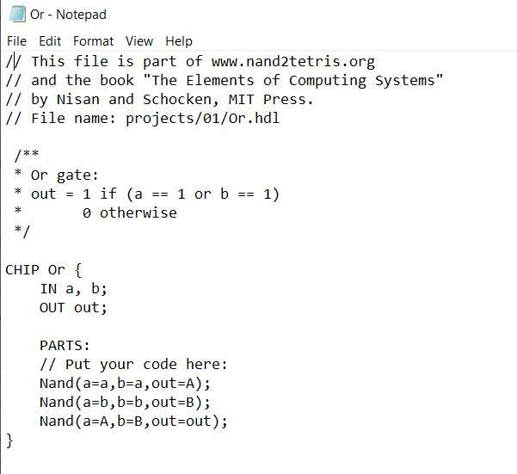
HDL script of OR Gate:

Slide 31
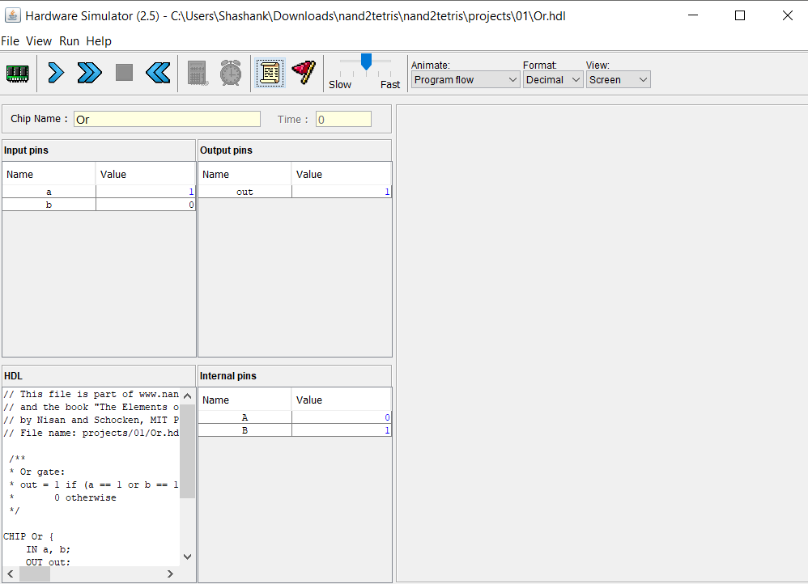
Result

Slide 32
Nor gate using Nand
Gate logic: NOR gate gives the complement of OR gate . We created OR gate earlier using NAND gate ,so to get the complement of it we must add one more NAND gate to it.
A
(A+B)’
B

Slide 33
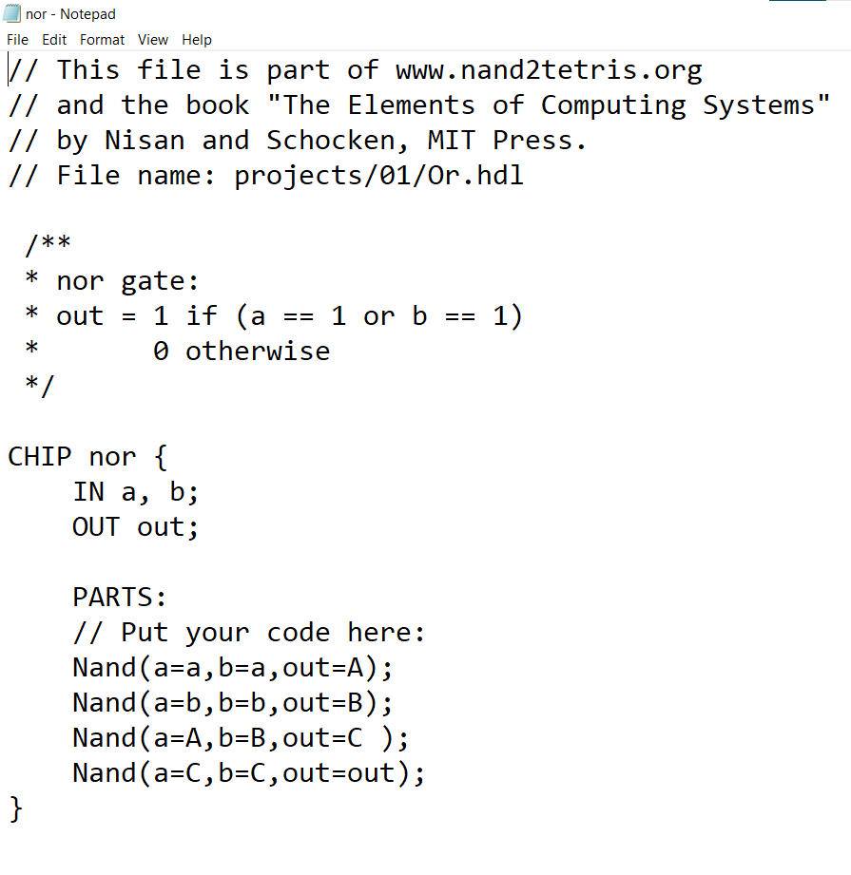
HDL Script for NOR gate

Slide 34
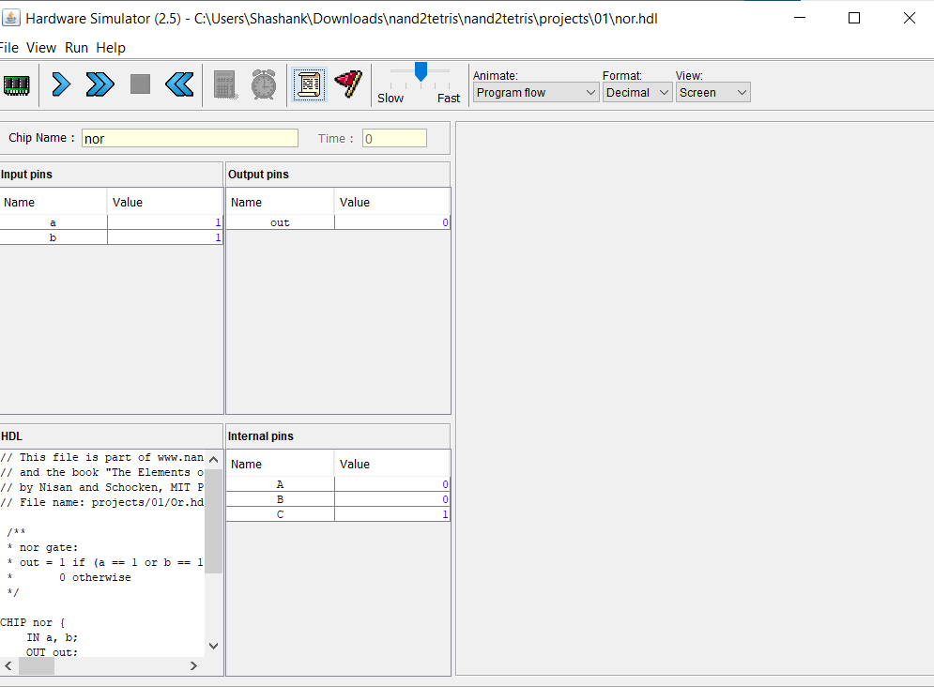
Result

Slide 35
THANK YOU
Group 43

